Slide 1

Teaching and Training
Our Youth
Proverbs 22:6
Notes:
Stuart Fain ~ February 16, 2025 Eloy (AM)
~ February 18, 2025 West Coast Preachers & Leaders Forum

Slide 2
Proverbs 22:6 (KJV)
Train up a child in the way he should go: and when he is old, he will not depart from it.

Slide 3
To Train:
To put something into the mouth
To give to be tasted
To give elementary instruction
Initiate a child in accordance with that child’s way

Slide 4
our Children’s Souls Need Us…
Loving Them Like Jesus Loved Them
Teaching Them to Love the Bible
Training Them with Time and Effort

Slide 5
Point #1: Loving Them Like Jesus Loved Them
Mark 10:13-14 (NAS)
Mathew 7:9-11 (KJV)

Slide 6
Mark 10:13-14 (NAS)
13 And they were bringing children to Him so that He might touch them; but the disciples rebuked them.

Slide 7
Mark 10:13-14 (NAS)
14 But when Jesus saw this, He was indignant and said to them, "Permit the children to come to Me; do not hinder them; for the kingdom of God belongs to such as these.

Slide 8
Mathew 7:9-11 (KJV)
9 Or what man is there of you, whom if his son ask bread, will he give him a stone?
10 Or if he ask a fish, will he give him a serpent?

Slide 9
Mathew 7:9-11 (KJV)
11 If ye then, being evil, know how to give good gifts unto your children, how much more shall your Father which is in heaven give good things to them that ask him?

Slide 10
Point #2: Teaching Them to Love the Bible
Psalms‬ ‭78‬:‭1‬-‭8 (NLT)‬‬‬
Ephesians 6:4 (KJV)
Deuteronomy 4:9 (NKJV)

Slide 11
Psalms‬ ‭78‬:‭1‬-‭8 (NLT)‬‬‬
¹ O my people, listen to my instructions. Open your ears to what I am saying, ² for I will speak to you in a parable. I will teach you hidden lessons from our past—

Slide 12
Psalms‬ ‭78‬:‭1‬-‭8 (NLT)‬‬‬
³ stories we have heard and known, stories our ancestors handed down to us. ⁴ We will not hide these truths from our children; we will tell the next generation about the glorious deeds of the Lord, about his power and his mighty wonders.

Slide 13
Psalms‬ ‭78‬:‭1‬-‭8 (NLT)‬‬‬
⁵ For he issued his laws to Jacob; he gave his instructions to Israel. He commanded our ancestors to teach them to their children, ⁶ so the next generation might know them— even the children not yet born— and they in turn will teach their own children.

Slide 14
Psalms‬ ‭78‬:‭1‬-‭8 (NLT)‬‬‬
⁷ So each generation should set its hope anew on God, not forgetting his glorious miracles and obeying his commands. ⁸ Then they will not be like their ancestors— stubborn, rebellious, and unfaithful, refusing to give their hearts to God.

Slide 15
Ephesians 6:4 (KJV)
And, ye fathers, provoke not your children to wrath: but nurture them in the chastening and admonition of the Lord.

Slide 16
Deuteronomy 4:9 (NKJV)
Only take heed to yourself, and diligently keep yourself, lest you forget the things your eyes have seen, and lest they depart from your heart all the days of your life. And teach them to your children and your grandchildren,

Slide 17
Point #3: Training Them with Time and Effort
Proverbs 22:15 (KJV)
Titus 2:3-4 (ASV)
Psalms 71:5 & 17 (NAS)
Psalm 34:11 (KJV)

Slide 18
Proverbs 22:15 (KJV)
Foolishness is bound in the heart of a child; but the rod of correction shall drive it far from him.

Slide 19
Titus 2:3-4 (ASV)
3 The aged women likewise, that they be in behaviour as becometh holiness, not false accusers, not given to much wine, teachers of good things; 4 That they may teach the young women to be sober, to love their husbands, to love their children,

Slide 20
Psalms 71:5; 17 (NAS)
5 For You are my hope; O Lord God, You are my confidence from my youth.
17 O God, You have taught me from my youth, And I still declare Your wondrous deeds.

Slide 21
Psalms 34:11 (KJV)
Come, ye children, hearken unto me: I will teach you the fear of the LORD.

Slide 22
Jerimiah 17:7-10 (NLT)
⁷ "But blessed are those who trust in the Lord and have made the Lord their hope and confidence.

Slide 23
Jerimiah 17:7-10 (NLT)
⁸ They are like trees planted along a riverbank, with roots that reach deep into the water. Such trees are not bothered by the heat or worried by long months of drought. Their leaves stay green, and they never stop producing fruit.

Slide 24
Jerimiah 17:7-10 (NLT)
⁹ "The human heart is the most deceitful of all things, and desperately wicked. Who really knows how bad it is?

Slide 25
Jerimiah 17:7-10 (NLT)
¹⁰ But I, the Lord, search all hearts and examine secret motives. I give all people their due rewards, according to what their actions deserve."

Slide 26
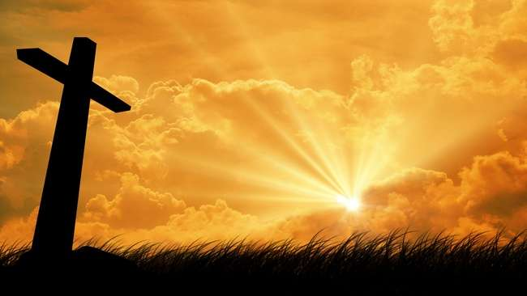
…that Christ died for our sins according to the scriptures; And that he was buried, and that he rose again the third day according to the scriptures:

Slide 27
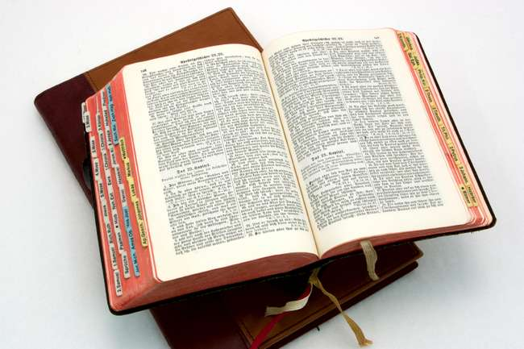
Hear: Romans 10:17
So then faith cometh by hearing, and hearing by the word of God.

Slide 28
Believe: Hebrews 11:6
But without faith it is impossible to please him: for he that cometh to God must believe that he is, and that he is a rewarder of them that diligently seek him.

Slide 29
Repent: Luke 13:3
I tell you, Nay: but, except ye repent, ye shall all likewise perish.

Slide 30
Confess: Matthew 10:32-33
32 Whosoever therefore shall confess me before men, him will I confess also before my Father which is in heaven.
33 But whosoever shall deny me before men, him will I also deny before my Father which is in heaven.

Slide 31
Baptize: Acts 22:16
And now why tarriest thou? arise, and be baptized, and wash away thy sins, calling on the name of the Lord.

